Slide 1
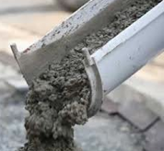
Navrattan High Performance Crete (NHPC)
Creator of:
A Green “Elastopolymeric”Cement Binder

Slide 2
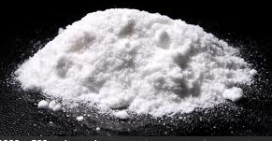
Our Technology uses a Proprietary Binder derived through a guarded extraction process, which ultimately transforms Organic Enzymes into a highly concentrated Elastic Polymeric Powder

Slide 3
An Elastomer is a polymer with Viscoelasticity. We use the name “Elastopolymer” because it best describes an Elastic Polymeric Cement that has Flexibility and Memory

Slide 4
The Magic of NHPC is that it binds by Covalent Bonding which is a joining of two atoms when the two share a pair of electrons.
Shared Pair Electrons
8P
8N
8P
8N
Oxygen Molecule

Slide 5
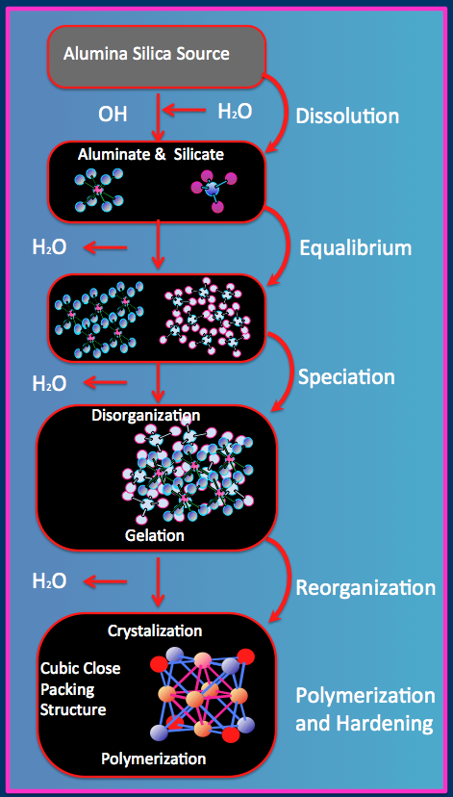
Individual polymer chains in the NHPC Proprietary binder are linked together by these Covalent Bonds to form one Single Molecule with all of the Aggregates. In addition, a thin plastic film cross links and permeates the entire mixture adding flexibility.

Slide 6
Due to the Covalent Bonding nature of NC cement, it becomes Monolithic, and cures by an Exothermic Reaction, which intrinsically expels the water.
Exothermic Reaction
Water expels from the center out

Slide 7
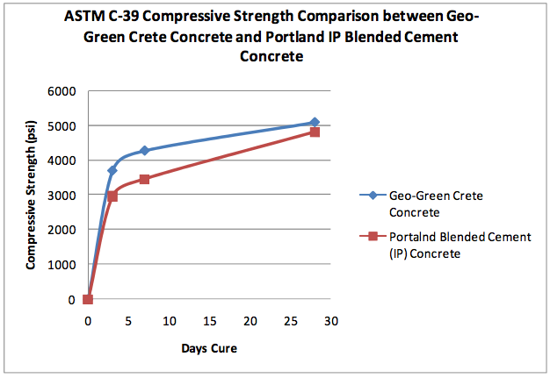
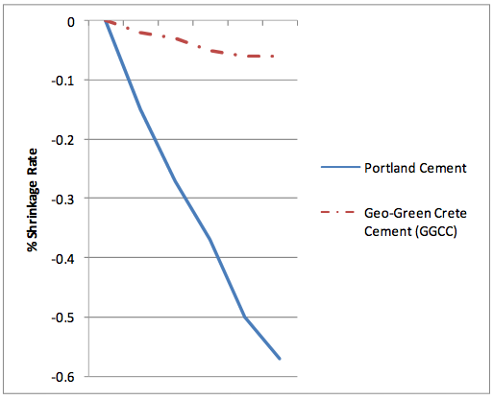
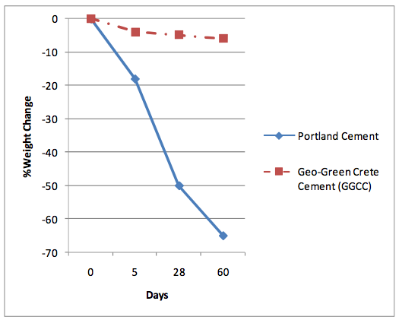
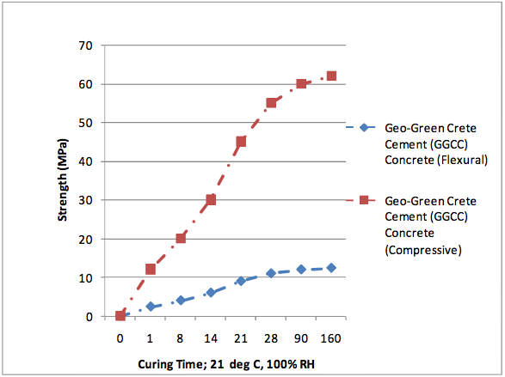
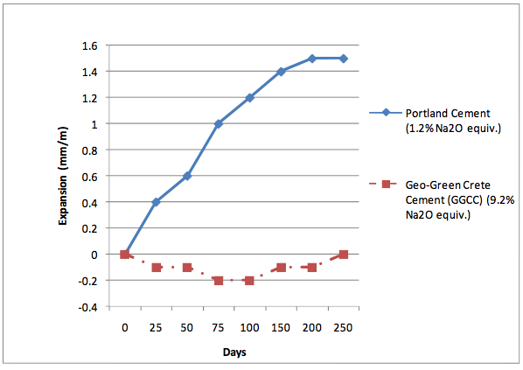
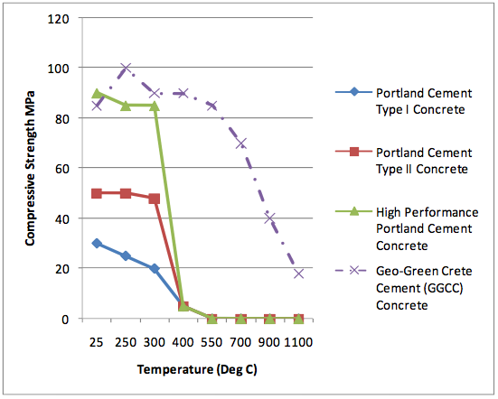
Structural Qualities
NC ….. Has Strengths that Can be Adjusted to Compression requirements
Has Higher Tensile Strength than Portland Cement due to its intrinsic covalent bonding nature. Meets and Exceeds all the Same Testing Standards as ordinary Portland cement (OPC), and Excels in Every category.

Slide 8
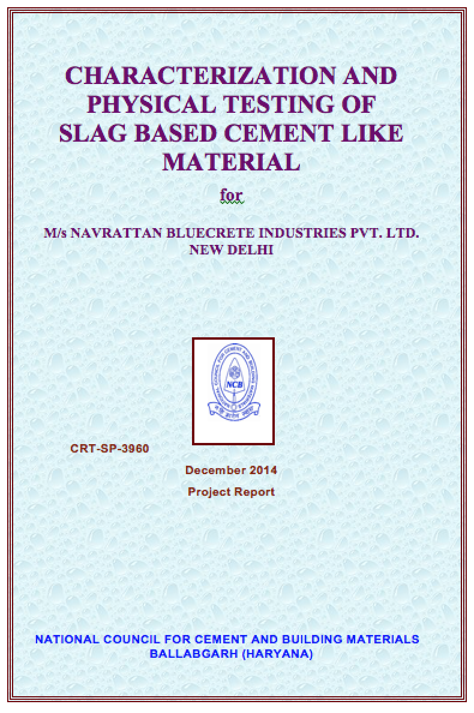
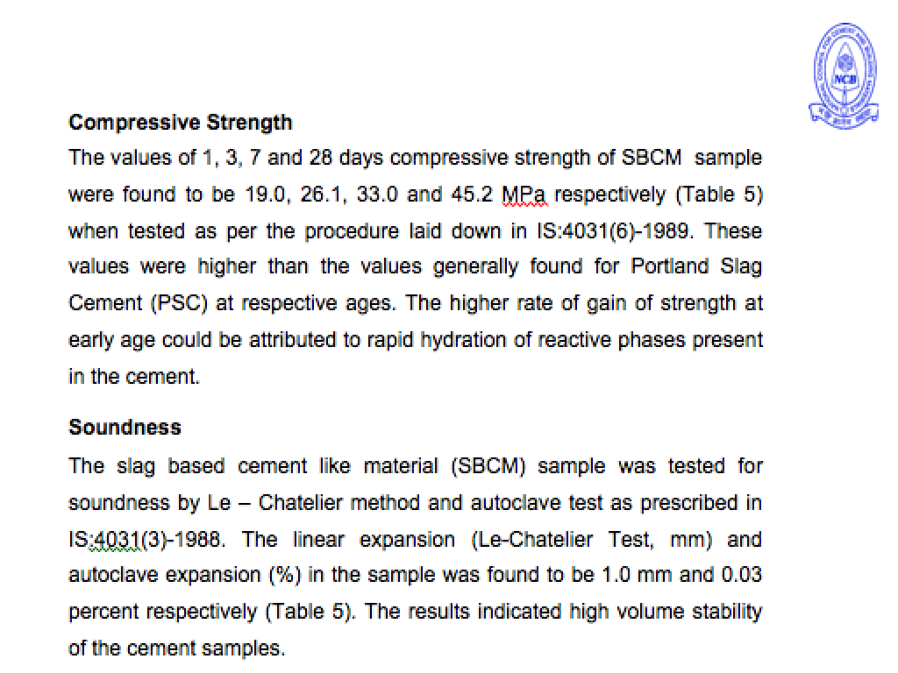
Testing at the NCBM in India

Slide 9
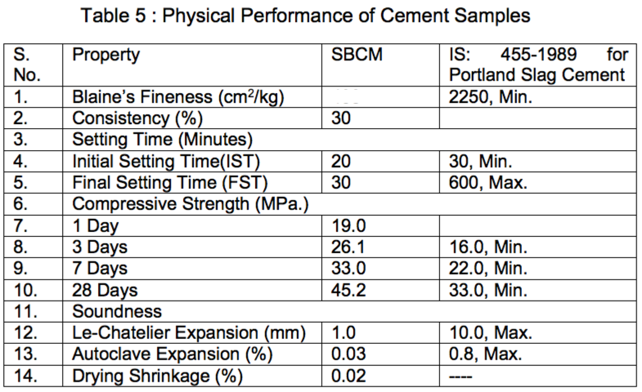
Testing at the NCBM in India

Slide 10
Structural Qualities
NHPC….. Has Low Coefficient of Expansion, and will work in freezing or tropical regions of the world. Is Highly-Resistant or impervious to water, acids, corrosion, sulfates and more.. Will NOT Corrode or Decompose Reinforcing, whether Steel, Fiberglass, Basalt, Hemp, or Bamboo.

Slide 11
NHPC has High Tensile Strength
Tension applied on thin piece
NHPC Coating Material
This NGC Sample measures only 1/16 ” thick x 1” wide x 3” Long

Slide 12
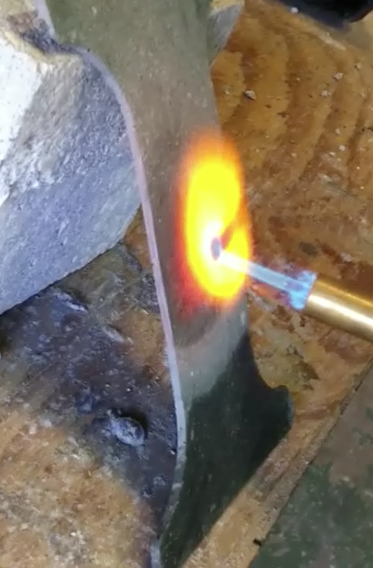
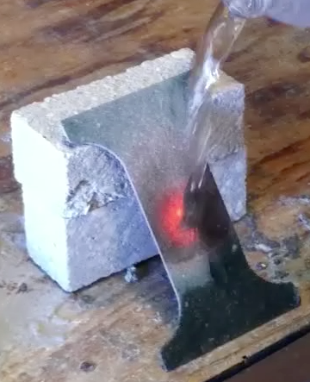
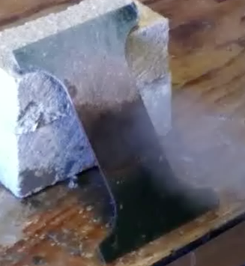
This is a WOW!!!
Does Not Explode
Thin saw cut NHPC Slice is Heated
Cold water Poured onto Hot NHPC Slice
This would be IMPOSSIBLE with Portland Cement

Slide 13
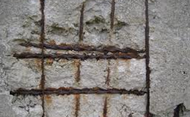
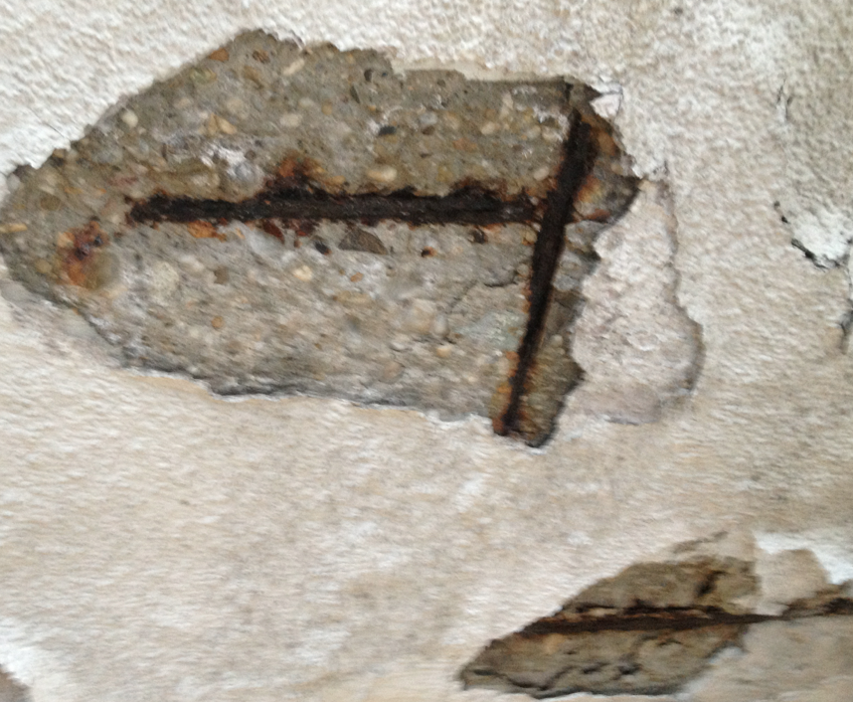
.
No More Rusty Re Bars
NHPC……. Absolutely Stops Oxidation ...your structures are forever.

Slide 14
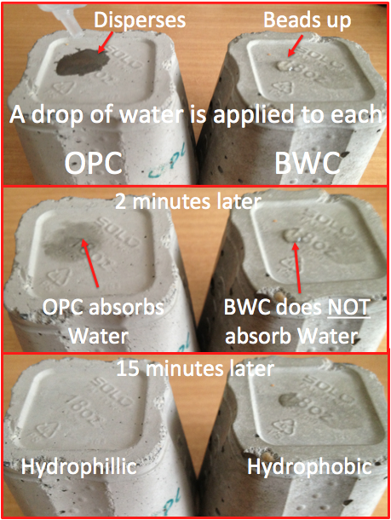
.
Permeablility.......Compare OPC with NHPC
NHPC
Is hydrophobic, which means liquids will not penetrate like they do with OPC.
Great for:
• Waterproof basements
• Pipe Coatings
• Countertops
• Wastewater tanks
• Fish Farms
• Boats, Docks
NHPC
NHPC

Slide 15
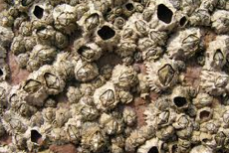
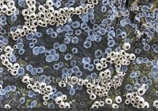
.
No Bacteria or Barnacles Can Live on NHPC
NC Surfaces are Ideal for Fish Farms, Boat Hulls, Docks
No Barnacles
No Bacteria

Slide 16
Acid will not Destroy NHPC
Portland Cement Deteriorating from exposure to Raw Sewage with 200 ppm Hydrogen Sulfide
A Portland Cement Block will dissolve in a Sulfuric acid solution in a few hours

Slide 17
.
NHPC will bond and Not Delaminate from Old Portland Cement
NGC Bonds Without Chemical Additives

Slide 18
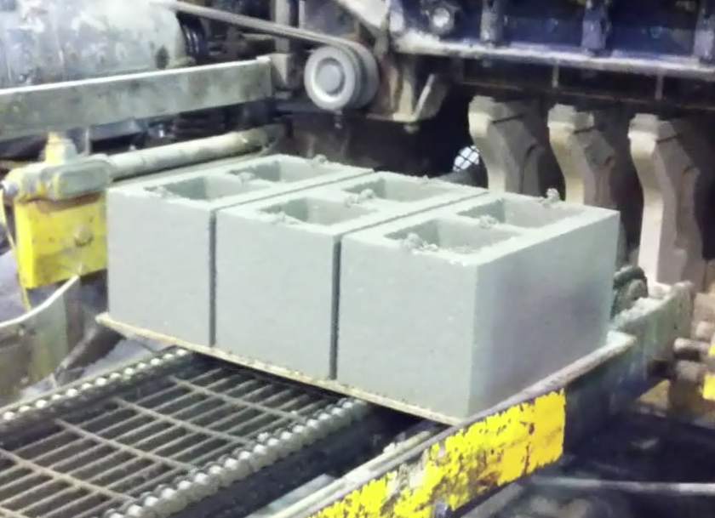
Set time
NHPC……. Can be Adjusted for Quick Setting Applications as in in Pre-casting, Slip-forming, and Extruding - and can at least double production using the same forms Can be formulated to have an Adjustable Set Time from minutes to several hours.
NHPC Cement blocks every 8 Seconds

Slide 19
Great - Insulator – almost no heat transfer
NHPC binder gives the cement superior insulating abilities no matter what aggregate is used – including cellulose or rock.
Portland blocks would probably explode with that much heat

Slide 20
.
Personal Safety
NHPC…….
Easier on the skin than lime based OPC

Slide 21
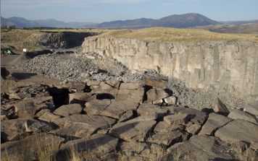
Environment
NHPC……. Releases No CO2 in production Process. Earn Carbon Credits Can Encapsulate a variety of aggregates, including Toxic and Radioactive Waste materials.

Slide 22
Application
NHPC ….. Can be Delivered on the same trucks
as traditional Portland cement.

Slide 23
NHPC Finishes just like traditional Concrete
And uses same tools

Slide 24
Financial Advantage
NHPC ….. Cement, and No Fossil Fuels or heating of materials are needed. Initial plant setup is fractional compared to setting up a cement factory, which would also include the cost of operating a limestone quarry.

Slide 25
Thank You for your undivided attention
NARATTAN High Performance Cement
For More Company Information
Click Below
http://www.navrattancement.com

